Slide 1


Welcome to my herror house
Dream Crusher
Magic quotes

Slide 2
Magic Quotes
Magic Quotes that was created to help protect newbie programmers from writing bad form processing code.

Slide 3

01.
_ _Construct()
Constructor is a special function that gets called automatically when the object of a class is created
Magic quote’s

Slide 4
_ _destruct()
destructor is a special function that gets called automatically when a class object is deleted or goes out of scope.

Slide 5

02
_ _Get( ), _ _Set( )
02
These are magic getters and setters for getting and putting values for class properties created dynamically by PHP property overloading.

Slide 6

03.
_ _call(), _ _callStatic()
These two magic methods are dedicated for accessing dynamically created but invisible methods on PHP method overloading. These differ, where __call() will invoke normal PHP overloaded methods, and __callStatic() will invoke static methods.
04.
_ _unSet ()
when we call PHP unset() function on such dynamically created properties, this magic method will automatically be invoked.

Slide 7
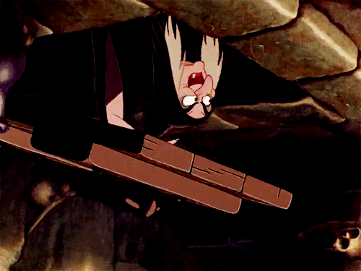
05.
_ _isSet ( )
These two magic methods are dedicated for accessing dynamically created but invisible methods on PHP method overloading. These differ, where __call() will invoke normal PHP overloaded methods, and __callStatic() will invoke static methods

Slide 8

_ _sleep( )
06
This will be invoked on calling PHP serialize() function. It will return object’s property array on cleaning PHP class objects before serialization.

Slide 9


_ _wakeup()
07
It will do the reverse work to restore objects properties and resources on invoking unserialize().

Slide 10

_ _toString()
08
This method is expected return a string value while using class instances with PHP printing statements. If we specify return values with any other data type, then the following error will occur.

Slide 11

09
_ _invoke()
This method defined in a class will be called when we make a function call with the name of that class instance.
10
_ _set_state()
This is a static method invoked while exporting objects property array and expects such array variable as its argument.

Slide 12
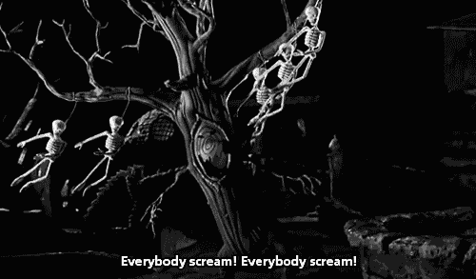
11
_ _clone()
As Cody pointed out, cloning in PHP is done by making a shallow copy of the object. This means that internal objects of the cloned object will not be cloned, unless you explicitly instruct the object to clone these internal objects too, by defining the magic method __clone()

Slide 13
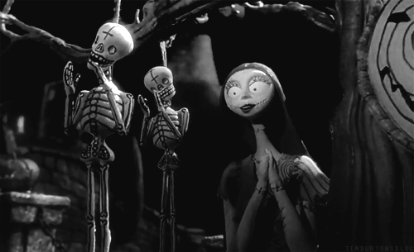
THANK YOU

